Slide 1

CAN THO UNIVERSITY COLLEGE OF INFORMATION AND COMMUNICATION TECHNOLOGY DEPARTMENT OF IMFORMATION TECHNOLOGY ***
BUILDING A SIMPLE NOTE-TAKING APPLICATION FOR ANDROID
BASIC THESIS
OF ENGINEERING IN INFORMATION TECHNOLOGY (HIGH-QUALITY PROGRAM)
Giảng viên hướng dẫn:
Dr. Trương Minh Thái
Sinh viên thực hiện:
Nguyễn Quang Vinh
MSSV: B2105727
Lớp: DI21V7F2
motphutcantho.com

Slide 2
DESCRIPTION
A simple, user-friendly note-takin application developed for Android.
motphutcantho.com

Slide 3
LIST OF FUNCTIONS
Navigation Drawer
Note
Checklist
Reminder and notification
Progress Tracker
motphutcantho.com

Slide 4
APPLIED TECHNOLOGY
Android studio
Kotlin
SQLite
motphutcantho.com

Slide 5
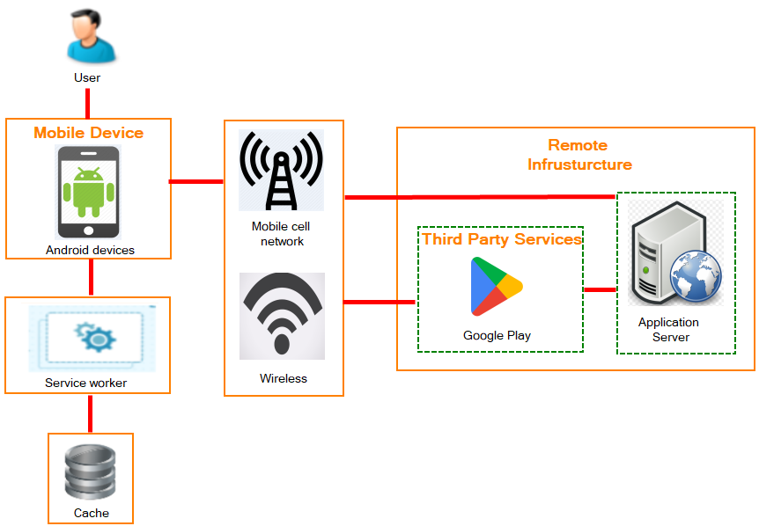
SYSTEM DESIGN
motphutcantho.com

Slide 6
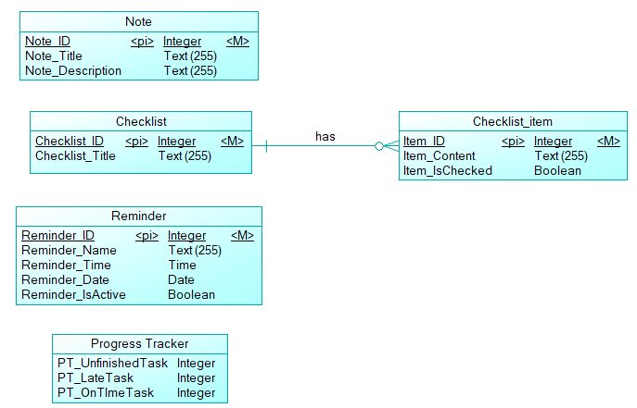
DATABASE DESIGN
motphutcantho.com

Slide 7
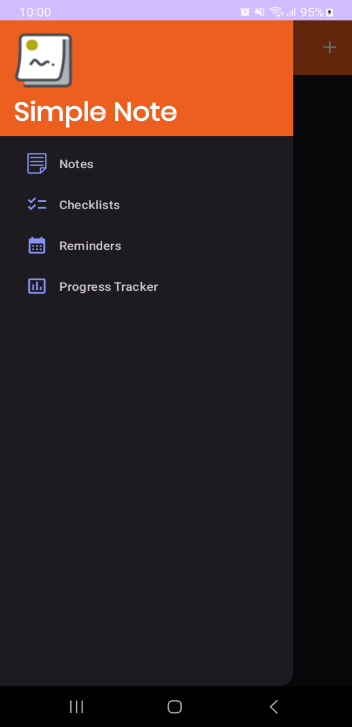
NAVIGATION DRAWER
motphutcantho.com

Slide 8
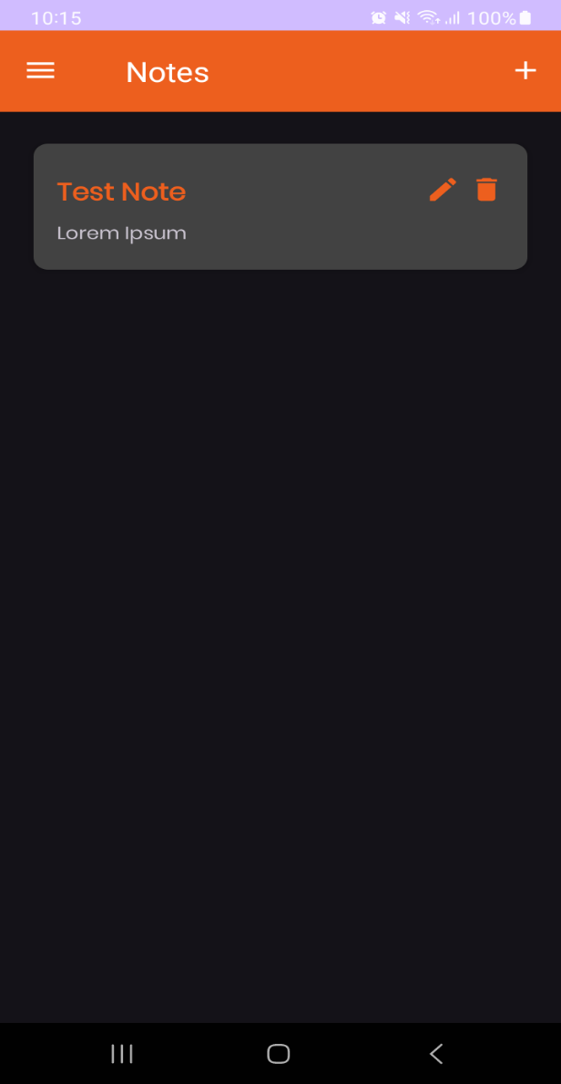
NOTE MENU
motphutcantho.com

Slide 9
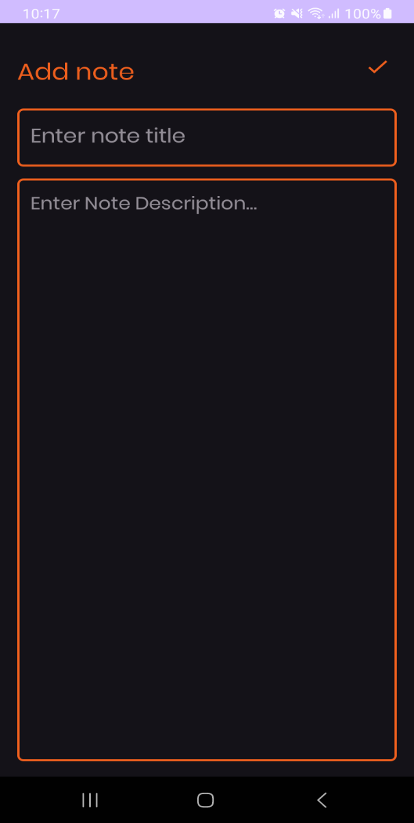
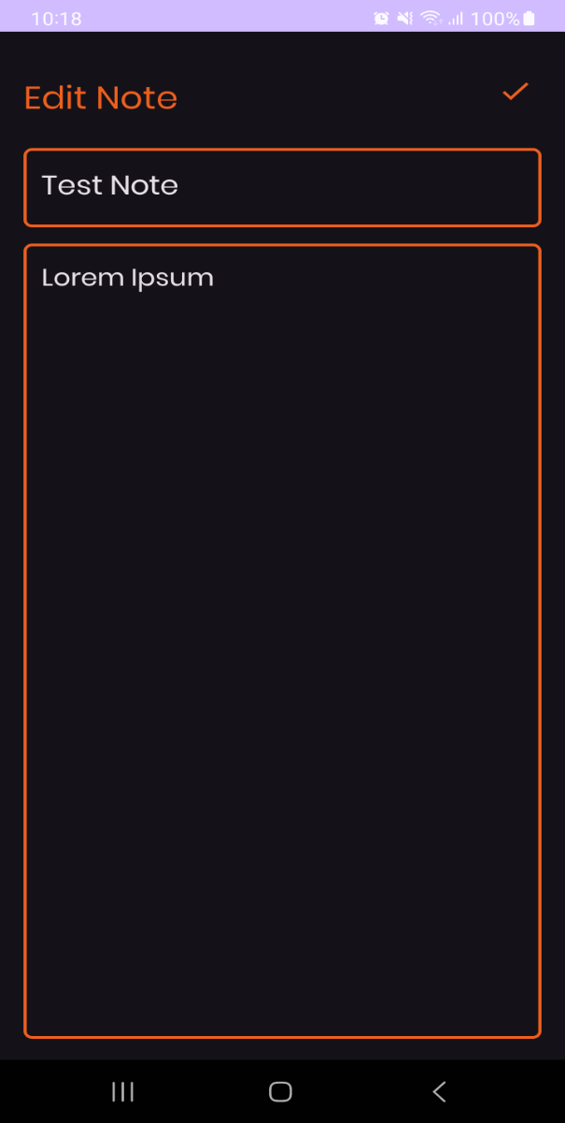
ADD NOTE AND EDIT NOTE
motphutcantho.com

Slide 10
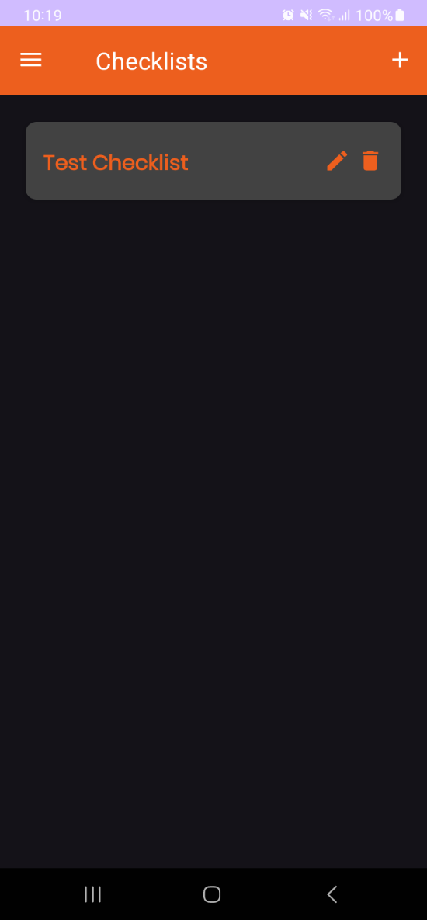
CHECKLIST MENU
motphutcantho.com

Slide 11
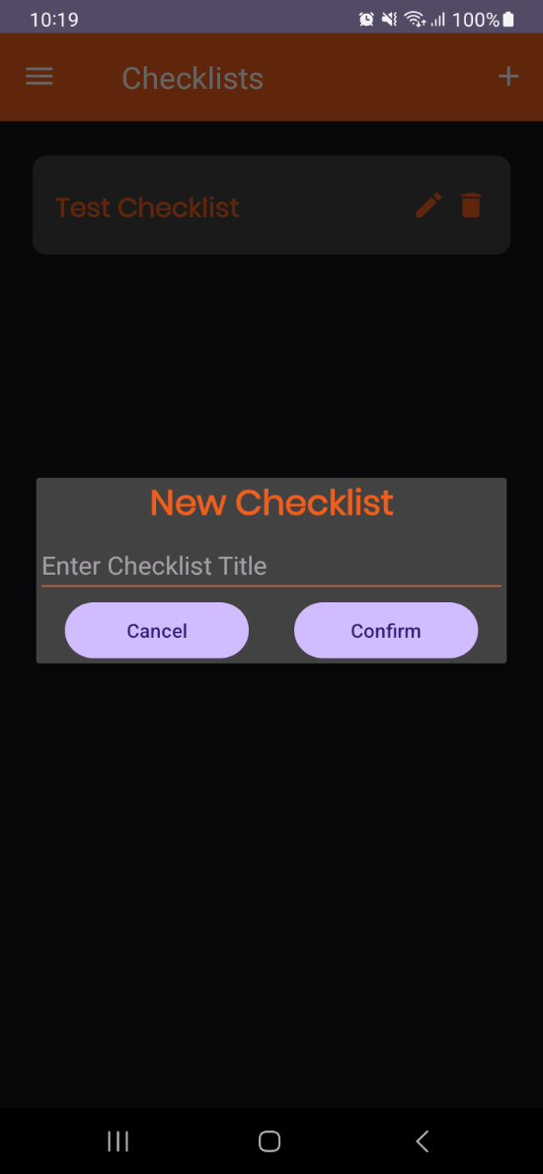
ADD CHECKLIST DIALOG
motphutcantho.com

Slide 12
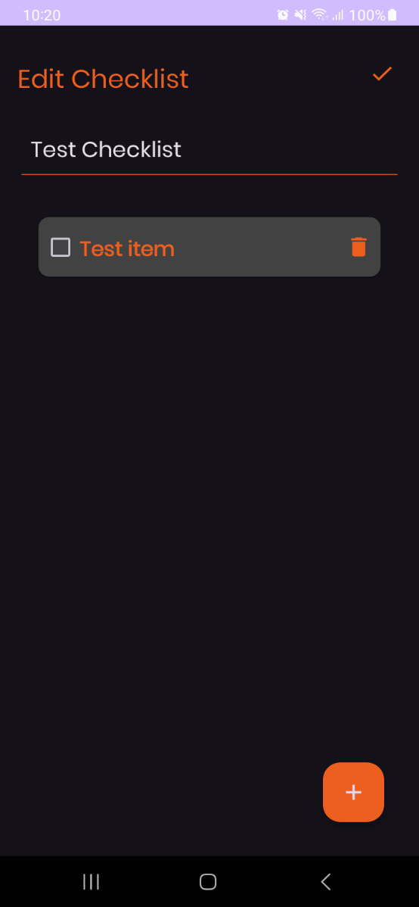
EDIT CHECKLIST
motphutcantho.com

Slide 13
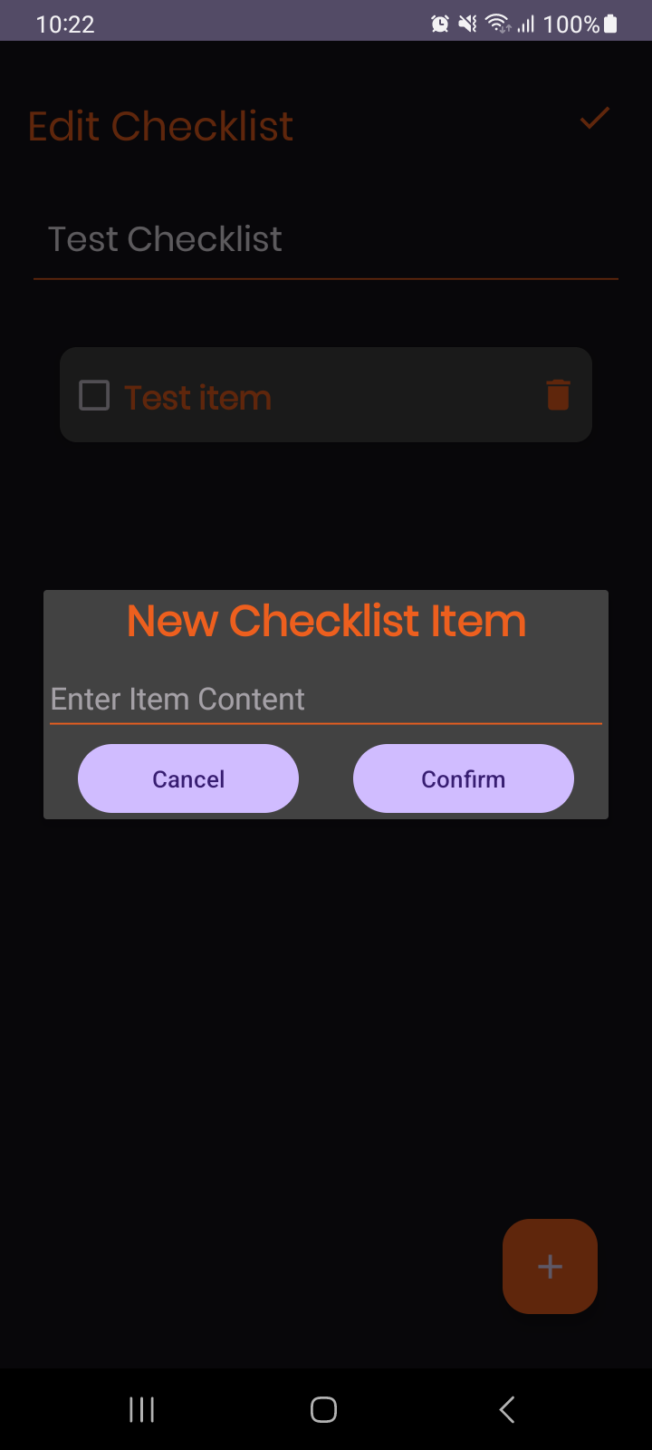
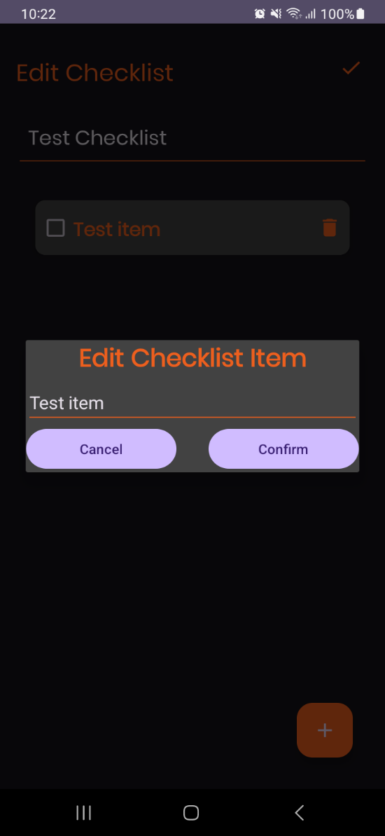
ADD AND EDIT ITEM DIALOG
motphutcantho.com

Slide 14
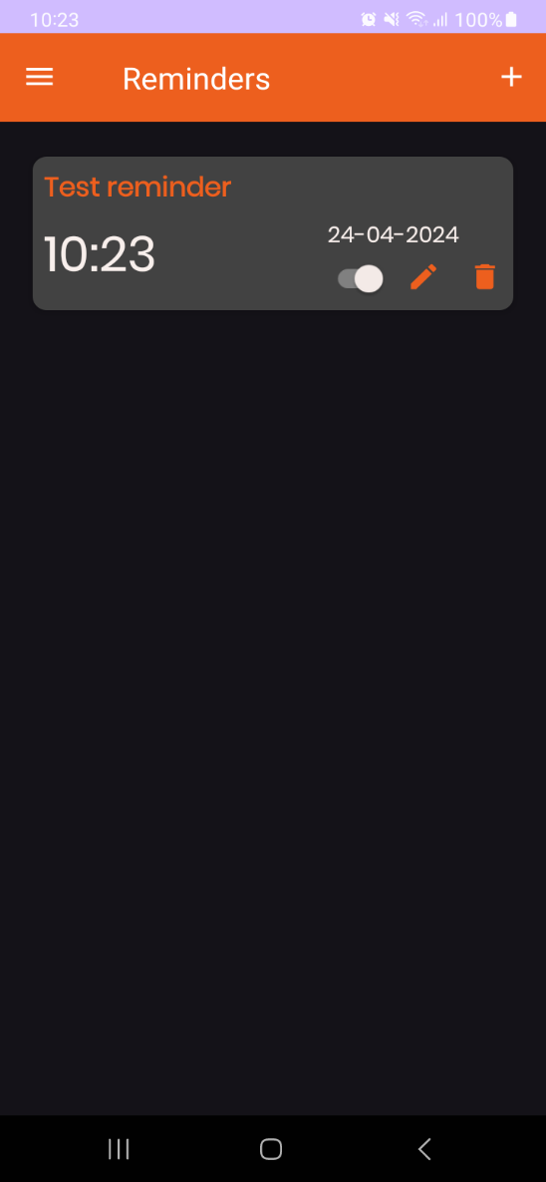
REMINDER MENU
motphutcantho.com

Slide 15
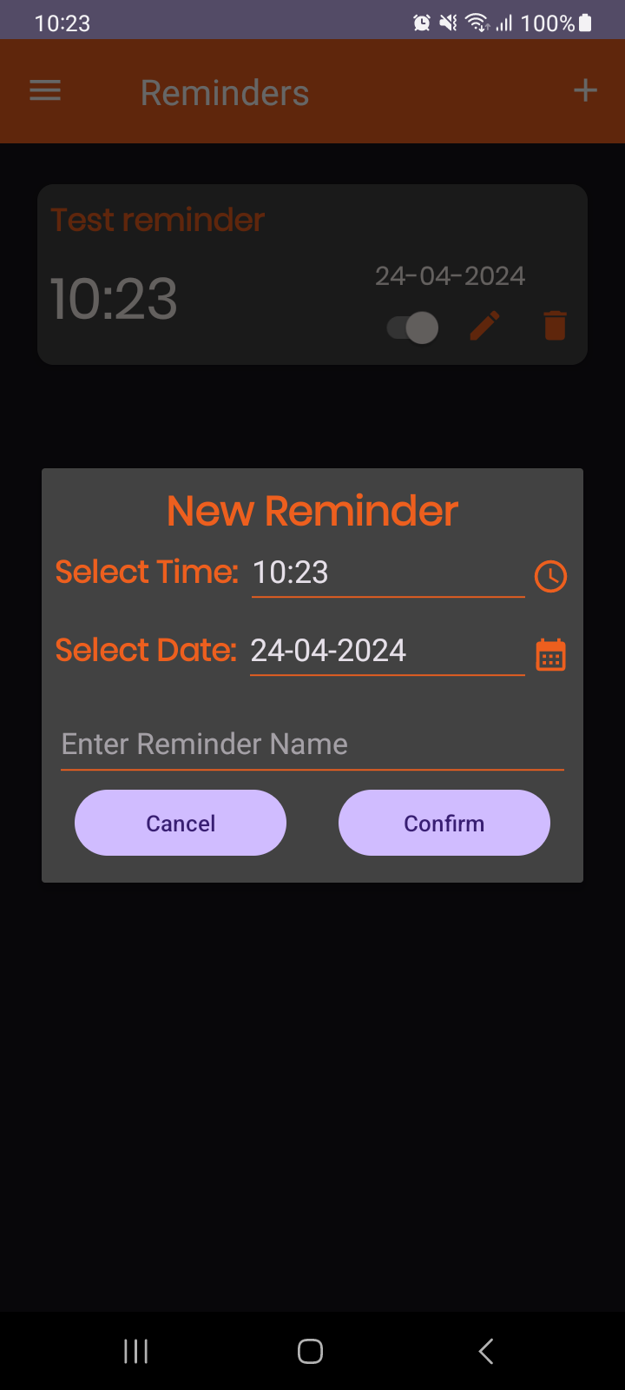
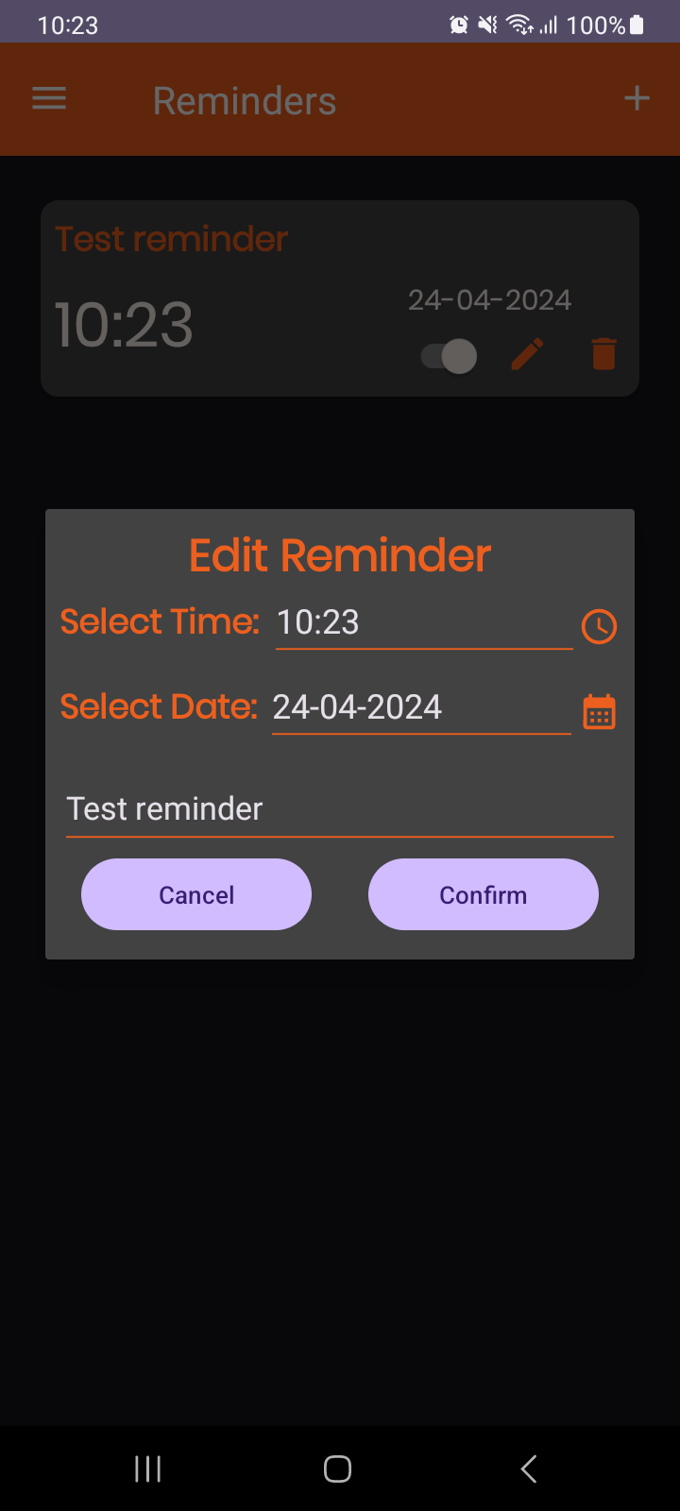
ADD AND EDIT REMINDER DIALOG
motphutcantho.com

Slide 16
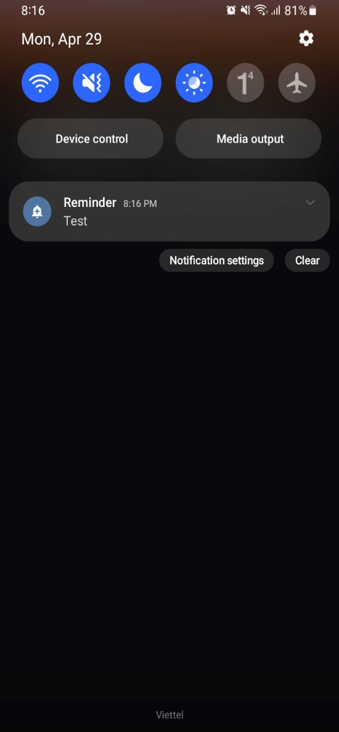
NOTIFICATION
motphutcantho.com

Slide 17
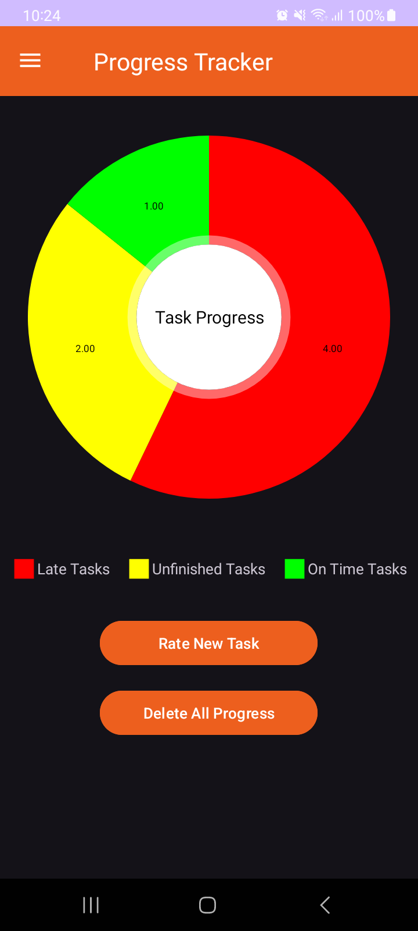
PROGRESS TRACKER MENU
motphutcantho.com

Slide 18
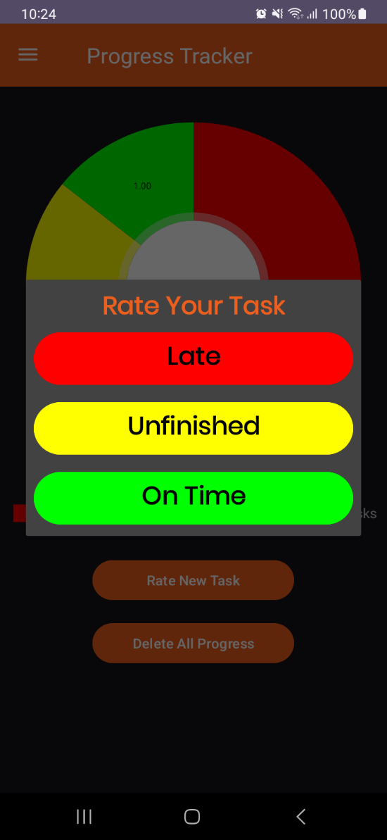
RATE TASK DIALOG
motphutcantho.com

Slide 19
Thanks for listening
motphutcantho.com

